Slide 1
Driver Alertness Detection
PIP2001 Capstone Project
Review-0
Batch Number: G-168
Roll Number | Student Name
20221LCS0012 | Parachuru Padma Sanjana
20221LCS0006 | Yakesh Krishnan.D
20221LCS0019 | Ashok K
20211CSE0482 | L.Jayakrishna
Under the Supervision of,
Mr.Afroj Alam
Professor / Associate Professor / Assistant Professor
School of Computer Science and Engineering
Presidency University
Name of the Program: CSE
Name of the HoD: Dr.Asif Mohammed H.B
Name of the Program Project Coordinator: Mr. Amarnath J.L & Dr. Jayanthi. K.
Name of the School Project Coordinators: Dr. Sampath A K / Dr. Abdul Khadar A

Slide 2
Content
Problem Statement
Github Link
Analysis of Problem Statement
Timeline of the Project
References

Slide 3
Problem Statement Number:
Organization : MindTree
Category (Hardware / Software / Both) : Both
Problem Description : Driver alertness is a major problem facing the transportation sector today. In India, about 1,37,000 people were killed in road accidents in 2013 alone which is more than all our wars put together. That is about an average of one death every 4 minutes. According to a survey, it has been found that about 37% of the Drivers fall asleep behind the wheel, While 60% admitted to driving drowsy. Through our project, we aim to create a compact add-on system for cars and trucks manufacturers which uses image processing to detect whenever the driver dozes off and quickly alerts him by alarm and/or vibrating mechanism. Also the system detects if the driver indulges in conversation with any co-passengers and alerts him/her against the same. The system involves a video camera fitted on the part of dashboard just in front of the driver. The camera output is processed either by an efficient on-board processor or using cloud computing services. Thus, using image processing we continuously locate the eyes of the driver. The system detects any delayed blinking pattern and sluggishness and activates the alarm to wake up the driver. Similarly, if the driver turns his/her head then our system will detect if the driver indulges in conversation with any copassengers beyond the safe limit and alerts the driver against the same. More specifically, head movement is monitored against the safe angle range of 100 degree. And if the timer is more than 2 sec then system will alert the device. If properly implemented in automobiles at manufacturing stage itself, like airbags, we believe this technology can save thousands of lives, not just in India, but across the globe
Difficulty Level : Simple

Slide 4
Github Link
The Github link provided should have public access permission.
Github Link
https://github.com/Parachuru1/driver-alertness-detection.git

Slide 5
Analysis of Problem Statement
Technology Stack Components :
The technology stack for the Driver Alertness System includes computer vision and machine learning models to detect driver eye closure and speech activity. The frontend can be built using React Native or Flutter for cross-platform support, while the backend can utilize Python (with OpenCV and TensorFlow) for real-time image and audio analysis. A buzzer alerts the driver if their eyes close for too long or if they are speaking to someone while driving, ensuring safety and attentiveness.

Slide 6
Analysis of Problem Statement (contd...)
Hardware Requirements:
Microprocessor:
Raspberry Pi (preferable due to GPIO support for interfacing the buzzer) or similar microcontroller like Arduino (though TensorFlow processing would need offloading to a computer).
Intel NUC or Jetson Nano for advanced AI processing on the edge.
Webcam:
Standard USB webcam (720p or above) or a Raspberry Pi Camera Module for real-time video capture.
Piezoelectric Buzzer:
A small piezo buzzer for generating audio alerts when drowsiness is detected.
Power Supply:
Power supply for the microprocessor (e.g., 5V/2A for Raspberry Pi).
Connectivity:
Internet connectivity may be required for cloud-based training or updates (Wi-Fi or Ethernet module).
Monitor and Keyboard (optional):
For initial setup and debugging of the system.

Slide 7
Analysis of Problem Statement (contd...)
Software Requirements:
Operating System:
For Raspberry Pi: Raspberry Pi OS (or any Linux-based OS for other microcontrollers).
For development on a computer: Linux, macOS, or Windows (preferred for OpenCV and TensorFlow compatibility).
Libraries and Dependencies:
OpenCV: For real-time image processing and frontal eye recognition.
HAAR Cascade Classifiers: Pre-trained models for eye and face detection.
TensorFlow: For machine learning models, either for advanced eye blink or facial expression recognition.
GPIO Libraries (for Raspberry Pi):
RPi.GPIO or gpiozero for controlling the piezoelectric buzzer.
IDE or Code Editor:
Any Python IDE such as PyCharm, VS Code, or even the built-in editor on the Raspberry Pi.

Slide 8
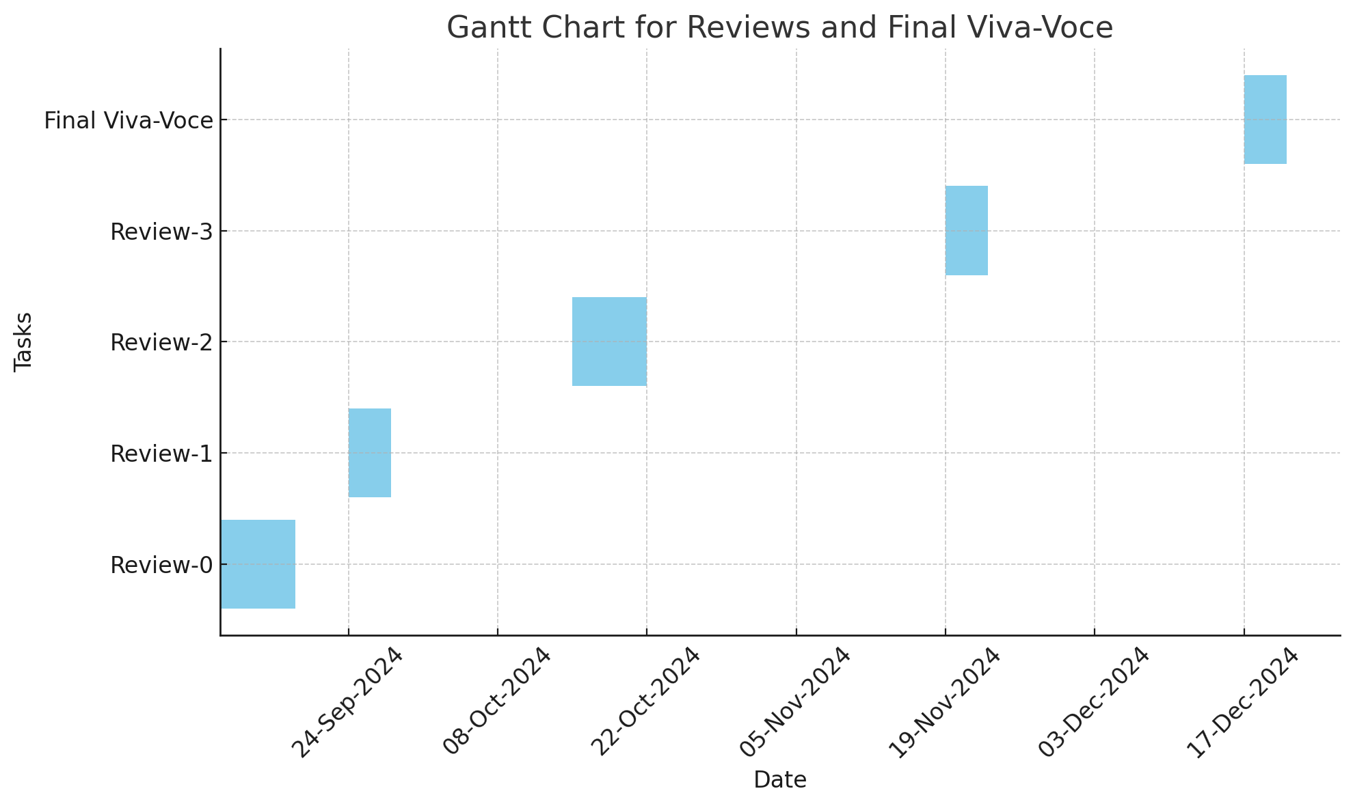
Timeline of the Project (Gantt Chart)

Slide 9
References (IEEE Paper format)
Haar, P. (2001). Rapid Object Detection using a Boosted Cascade of Simple Features. In Proceedings of the 2001 IEEE Computer Society Conference on Computer Vision and Pattern Recognition (CVPR).
Ali, F. F., & Ashraf, I. (2020). A comprehensive review of driver drowsiness detection systems. IEEE Access, 8, 23480-23502. doi:10.1109/ACCESS.2020.2971965
Cohen, H., & Keren, N. (2015). Detection of drowsiness in drivers using facial features. Proceedings of the IEEE Intelligent Vehicles Symposium, 2015, 926-931. doi:10.1109/IVS.2015.7196048

Slide 10


